Slide 1
Gaussian Mixture
A Gaussian mixture model is a probabilistic model that assumes all the data points are generated from a mixture of a finite number of Gaussian distributions with unknown parameters.

Slide 2
What is Gaussian mixture model in machine learning?
So in ML we use,
Gaussian mixture models are a probabilistic model for representing normally distributed subpopulations within an overall population. ... Estimating the parameters of the individual normal distribution components is a canonical problem in modeling data with GMMs.

Slide 3
Package
sklearn.mixture is a package which enables one to learn Gaussian Mixture Models (diagonal, spherical, tied and full covariance matrices supported)
A GaussianMixture.fit method is provided that learns a Gaussian Mixture Model from train data. Given test data, it can assign to each sample the Gaussian it mostly probably belong to using the GaussianMixture.predict method.
The GaussianMixture comes with different options to constrain the covariance of the difference classes estimated: spherical, diagonal, tied or full covariance.

Slide 4
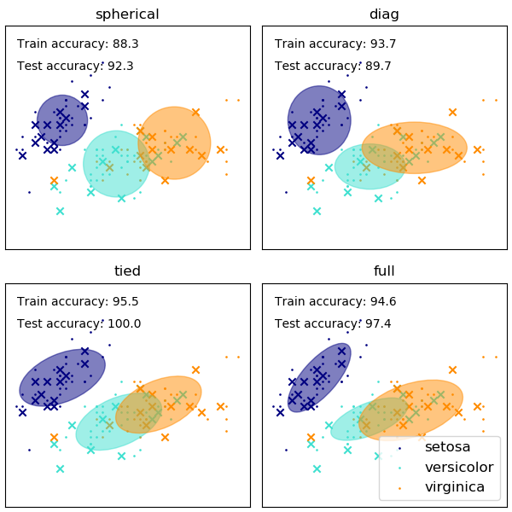

Slide 5
Pros & Cons
Advantages
Speed
Agnostic
Disadvantages
Singularities
Number of components

Slide 6
Variation Bayesian Gaussian Mixture
The Bayesian Gaussian Mixture object implements a variant of the Gaussian mixture model with vibrational inference algorithms. The API is similar as the one defined by Gaussian Mixture.
Vibrational inference is an extension of expectation-maximization that maximizes a lower bound on model evidence (including priors) instead of data likelihood.
Due to its Bayesian nature, the vibrational algorithm needs more hyper- parameters than expectation-maximization, the most important of these being the concentration parameter weight_concentration_prior
Specifying a low value for the concentration prior will make the model put most of the weight on few components set the remaining components weights very close to zero. High values of the concentration prior will allow a larger number of components to be active in the mixture.

Slide 7
